Slide 1
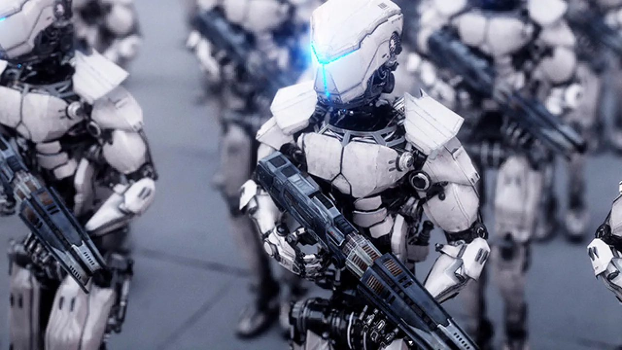
Autonomous Robot Soldiers
Topic Selection
Over the years, technology has played an increasingly significant role in the area of modern warfare, with one notable example being autonomous weapons systems, which are systems that are able to identify and engage targets without human intervention (Baecker 2019). Because of the exponential advancement and limitless potential of artificial intelligence (AI), as well as the development of modern robotics and military technology, autonomous weapons have achieved new heights, with increased effectiveness and deployment capabilities.
Baecker (2019) claims that robot soldiers "will likely move from labs to real deployment in the very near future" (p. 177). Multiple countries, namely Russia, China, and the United States have demonstrated their robot solder technology and are heavily investing in the research and development of AI.
Opportunities
Minimizing human casualties
Always follow orders
Increased combat effectiveness / precision

Slide 2
Risks and Choices
Risks
Vulnerabilities to Cyber and Adversarial Attacks - Russia claimed that the U.S. took control of 13 UAVs and attempted to use them to attack a Russian military base in Syria (Associated Press 2018).
Lack of Accountability – Asaro argues that current autonomous weapons are not legal or moral agents that can be held morally responsible or legally accountable for their choices and actions (2020).
Lowering the threshold to war – By taking humans out of the kill chain, mass produced robots potentially lowers the the barrier of entry to such global-scale conflicts.
Poor Judgement in Complex Situations - "Artificial systems lack certain human qualities, such as emotion, compassion, and the ability to understand humans.” (Marco Sassoli, 2014)
Choices
Development Path – Is it worthwhile to allocate a significant amount of resources to the development of autonomous robot soldiers, or would it be more beneficial to invest those resources in other military applications?
Level of Autonomy – What level of autonomy should be given to the robot soldiers? Should they be semi-autonomous, allowing humans to intervene in their actions at any point, or should they be fully autonomous, operating independently without any human input?

Slide 3
Group Responsibilities
Each of our group members had their own responsibility regarding the project
Trevre – Github repository manager, Reasearcher & Writer
Researched and wrote about the choices and ethics involved with the topic. Managed the GitHub repository and helped create the website.
James – Web designer, Researcher & Writer
Researched and wrote about the topic definition and the opportunities with it. Helped create the website
Patricia – Proofreader, Researcher and Writer
Researched and wrote about the risks and issues related to the topic presented. Proofread the topic descriptions and helped create the website.

